Slide 1
Security in Automobiles: Vulnerability and Protection of the on-board diagnostics port (OBD-II)
Michiel Willems, 01/02/19
Master of Engineering: Computer Science (Secure software)
Promotor: prof.dr. Bruno Cripso, Assistants: Mahmoud Ammar & Hassaan Janjua
Assesors: Dr. J.T. Mühlberg & Prof. dr. D. Weyns

Slide 2
Outline
Introduction
Background
Securing the OBD-II port
Implementation
Evaluation
Conclusion
Notes:
Pretty much follows thesis structure.
No verbal summation (not a fan)

Slide 3
Introduction

Slide 4
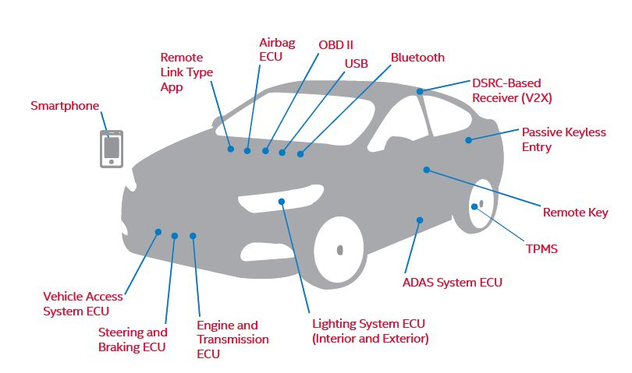
Introduction – Context
https://www.telematicswire.net/articles_interviews_qa-2/articles_inhouse_invited/cybersecurity-a-gating-issue-for-safety-in-a-connected-and-automated-vehicle-future/
Notes:
Automobile hacking major concerns of software security.
100Milion lines of code, spread out over 70 ECU’s
ECU’s connected via networking protocols (i.e. CAN).
Increased connectability = More attack surfaces
Some example attack surfaces:
- Bluetooth (Bluetooth large protocol stack, lots of vulnerabilities).
- Tire Pressure Monitoring System: transmit false packets.
- OBD-II is one of these attack surfaces.

Slide 5
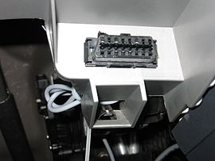
Introduction – Problem Statement
On-Board Diagnostics (OBD-II)
Help technicians diagnose and repair complex problems
Allows access to vehicle subsystems via connector.
Works with multiple signalling protocols (CAN mostly used).
https://en.wikipedia.org/wiki/On-board_diagnostics
Allen Lyons, California Air Resources Board , On-Board Diagnostics (OBD) Program Overview, 2015 .
Notes:
1996: The OBD-II specification is made mandatory for all cars manufactured in the United States to be sold in the United States.

Slide 6




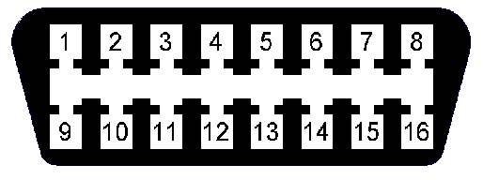
Introduction – Problem Statement
Central Gateway
Sub-Networks
CAN
User
Intra Vehicle Network
Notes:
Normal situation: User connects to internal network via OBD-II DLC to retrieve diagnostics info.
Dangerous situation: User replaced by attacker, gaining easy access to internal network, injecting arbitrary messages.
These messages could trick systems into performing certain actions erroneously.

Slide 7
Challenges
Compatibility
portability, practicality, no hardware modifications.
Performance
Speed, no interference with other systems.
Security
Protect against unauthorised access.

Slide 8
Contribution
The proposal of a role-based access control model for OBD-II, based on public-key cryptography.
Provide open source ‘proof-of-concept’ implementation on resource-constrained hardware and evaluate based on proposed challenges.

Slide 9
Background

Slide 10
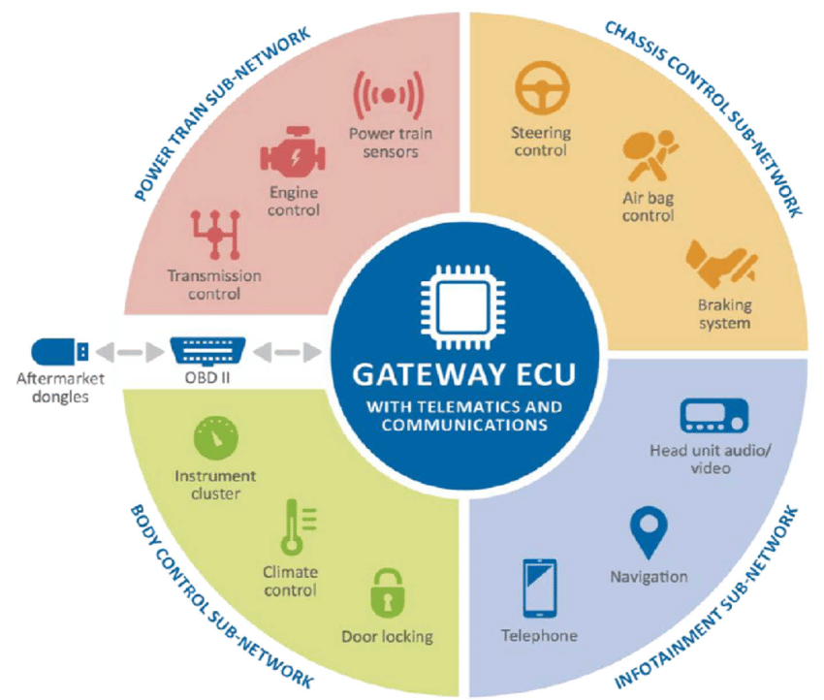
Background – Intra vehicle networks
Cyber security and resilience of smart cars. Technical report, Agency for Network and Information Security (ENISA), 2016.
Notes:
Typical intra vehicle network consists of multiple sub-networks with different responsebilities.
Each sub-network uses a distinct networking protocol that best suit its needs.
CAN is mostly used.
Key component = Gateway, performs signal mapping between different sub-networks + Handles incoming OBD-II transmissions.

Slide 11
Background – CAN
Controller Area Network:
Bus connecting ECU’s inside vehicle.
Carrier Sense Multiple Access with Collision Avoidance (CSMA/CA)
Identifier (ID) identifies content, not sender/receiver.
ID also determines priority.
No support for security.
ISO11898-1. Road vehicles – controller area network (can) – part 1: Data link layer and physical signalling. Technical report, International Organization for Standardization, 2015.
ISO11898-2: Road vehicles – controller area network (can) – part 2: High-speed medium access unit. Standard, International Organization for Standardization, 2016.
ISO11898-3: Road vehicles – controller area network (can) – part 3: Low- speed, fault-tolerant, medium-dependent interface. Standard, International Organization for Standardization, 2016.
Notes:
Eavesdropping
No authentication
No encryption
Denial of service (DoS)

Slide 12
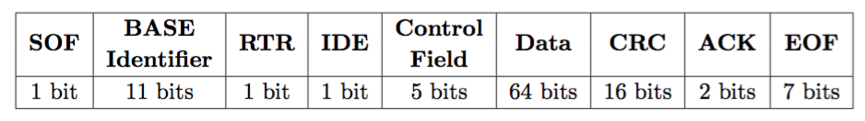
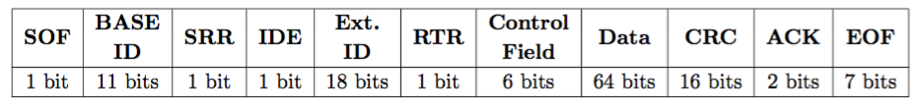
Background – CAN
Frame formats:
ISO11898-1. Road vehicles – controller area network (can) – part 1: Data link layer and physical signalling. Technical report, International Organization for Standardization, 2015.
ISO11898-2: Road vehicles – controller area network (can) – part 2: High-speed medium access unit. Standard, International Organization for Standardization, 2016.
ISO11898-3: Road vehicles – controller area network (can) – part 3: Low- speed, fault-tolerant, medium-dependent interface. Standard, International Organization for Standardization, 2016.
Notes:
2 types: BASE type and Extended type.
Difference: extended has longer id (29 instead of 11)
Max Data of 8 bytes.

Slide 13
Background – OBD-II
Data Link Connector (DLC).
Parameter ID’s (PID) to request data.
Diagnostic trouble codes (DTC) to identify faults.
Signalling protocols to handle communications (ISO-TP).
Hardware tools and adaptors.
ISO15031-5. Road vehicles – communication between vehicle and external equipment for emissions-related diagnostics – part 5: Emissions-related diagnostic services. Standard, International Organization for Standardization, 2015.
ISO15031-6. Road vehicles – communication between vehicle and external equipment for emissions-related diagnostics – part 6: Diagnostic trouble code definitions. Standard, International Organization for Standardization, 2015.
Wikipedia contributors. On-board diagnostics — Wikipedia, the free encyclopedia, 2018. [Online; accessed 29-November-2018]. URL: https://en.wikipedia. org/w/index.php?title=On-board_diagnostics&oldid=870086948.
Notes:
DLC = 16pin connector with two types with different voltages
DTC’s comparable to Java Exceptions.
Split message up into different CAN frames.
Hardware tools different types: standard OBD-II diagnostics tool, one with bluetooth/wifi compatability, one with USB connector.

Slide 14
Background – OBD-II
DLC
Central Gateway
Sub-Networks
ISO-TP
User
Diagnostic
scanning tool
Intra Vehicle Network
Notes:
Give example of how OBD-II works.

Slide 15
Securing the OBD-II port

Slide 16
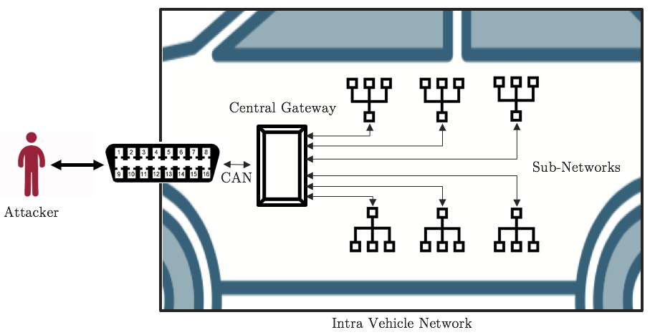
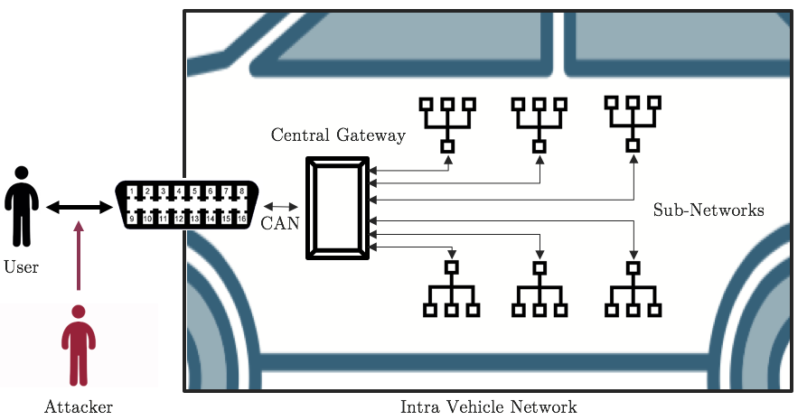
Attacker Model
Type of Access:
Physical Access:
Session Hijacking:
Notes:
Attacker Types:
Targeting driver/passenger safety.
Alteration by legitimate users.
Surveillance.
Theft.

Slide 17


Securing the OBD-II port – Role Based Access Control
Private keys
OBD-II Server
Internet
Connection
Central Gateway
Sub-Networks
ISO-TP
User
Public keys
Intra Vehicle Network
Notes:
OBD-II Role-based access control.
Each public/private key-pair associated with a specific role.
Each role will have permission to send a subset of messages (permission table)
Private keys stored on a obd-II server
Public keys stored on central gateway.
User first authenticates to the OBD-II server (e.g. login and password).
User will facilitate authentication to gateway by proving (s)he has access to OBD-II server (i.e. private key).

Slide 18
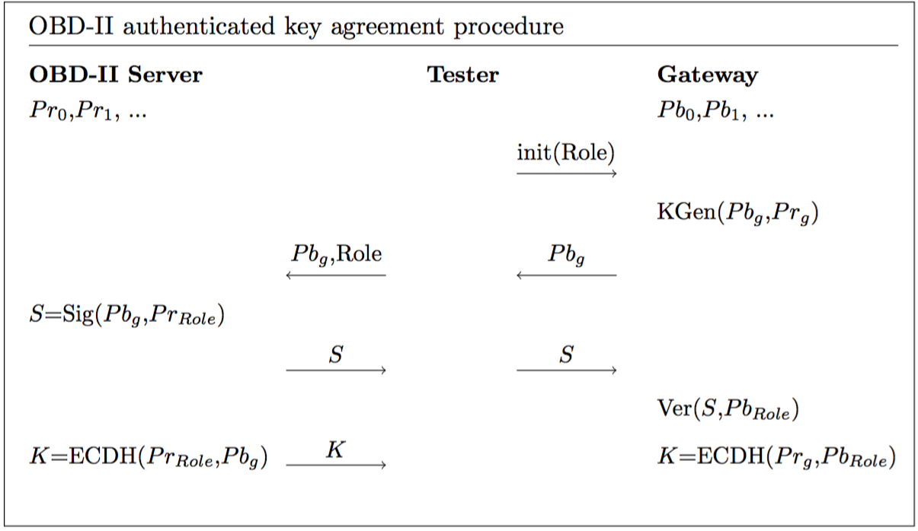
Securing the OBD-II port
Notes:
ECC because of it’s speed (optional: make comparison like 26 minutes (RSA DS) versus 6 seconds (ECDSA). Atmega328 microcontroller 16Mhz
Discuss procedure
Init message also contains role
Result: Central server authenticated to gateway. (i.e. use has access to central server).
Result: Both tester and gateway calculated shared secret.

Slide 19
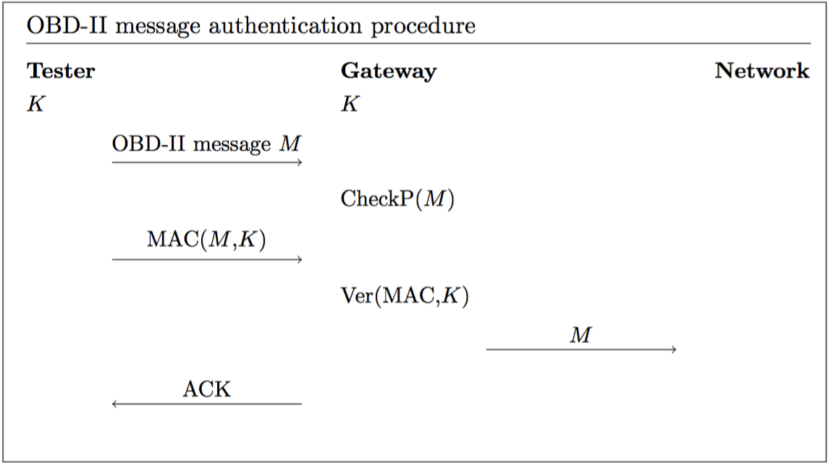
Securing the OBD-II port
Notes:
Discuss procedure

Slide 20
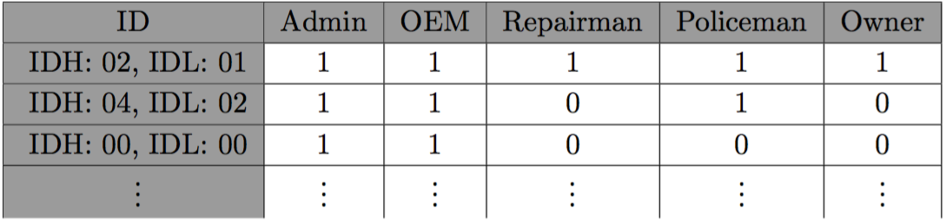
Securing the OBD-II port
Permission Table
Charlie Miller and Chris Valasek. Adventures in automotive networks and control units. 2014
Notes:
Explain different roles: Admin, OEM, Repairman, Policeman, Owner
Examples (2010 Ford Escape):
0201: speedometer
0402: odometer
0000: DoS

Slide 21
Implementation

Slide 22
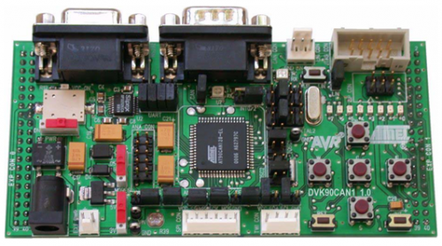
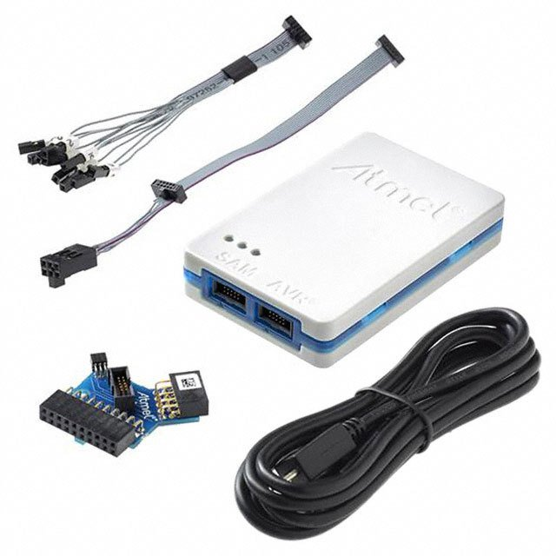
Implementation
Hardware: 2 x DVK90CAN1
AT90CAN128 MCU (8 MHz)
CAN Transceiver + Connector
RS-232 driver/receiver + Connector
Compass Card Keyboard
Atmel-ICE Basic Programmer (JTAG)
http://ww1.microchip.com/downloads/en/devicedoc/doc4381.pdf
https://www.microchip.com/developmenttools/ProductDetails/atatmel-ice

Slide 23
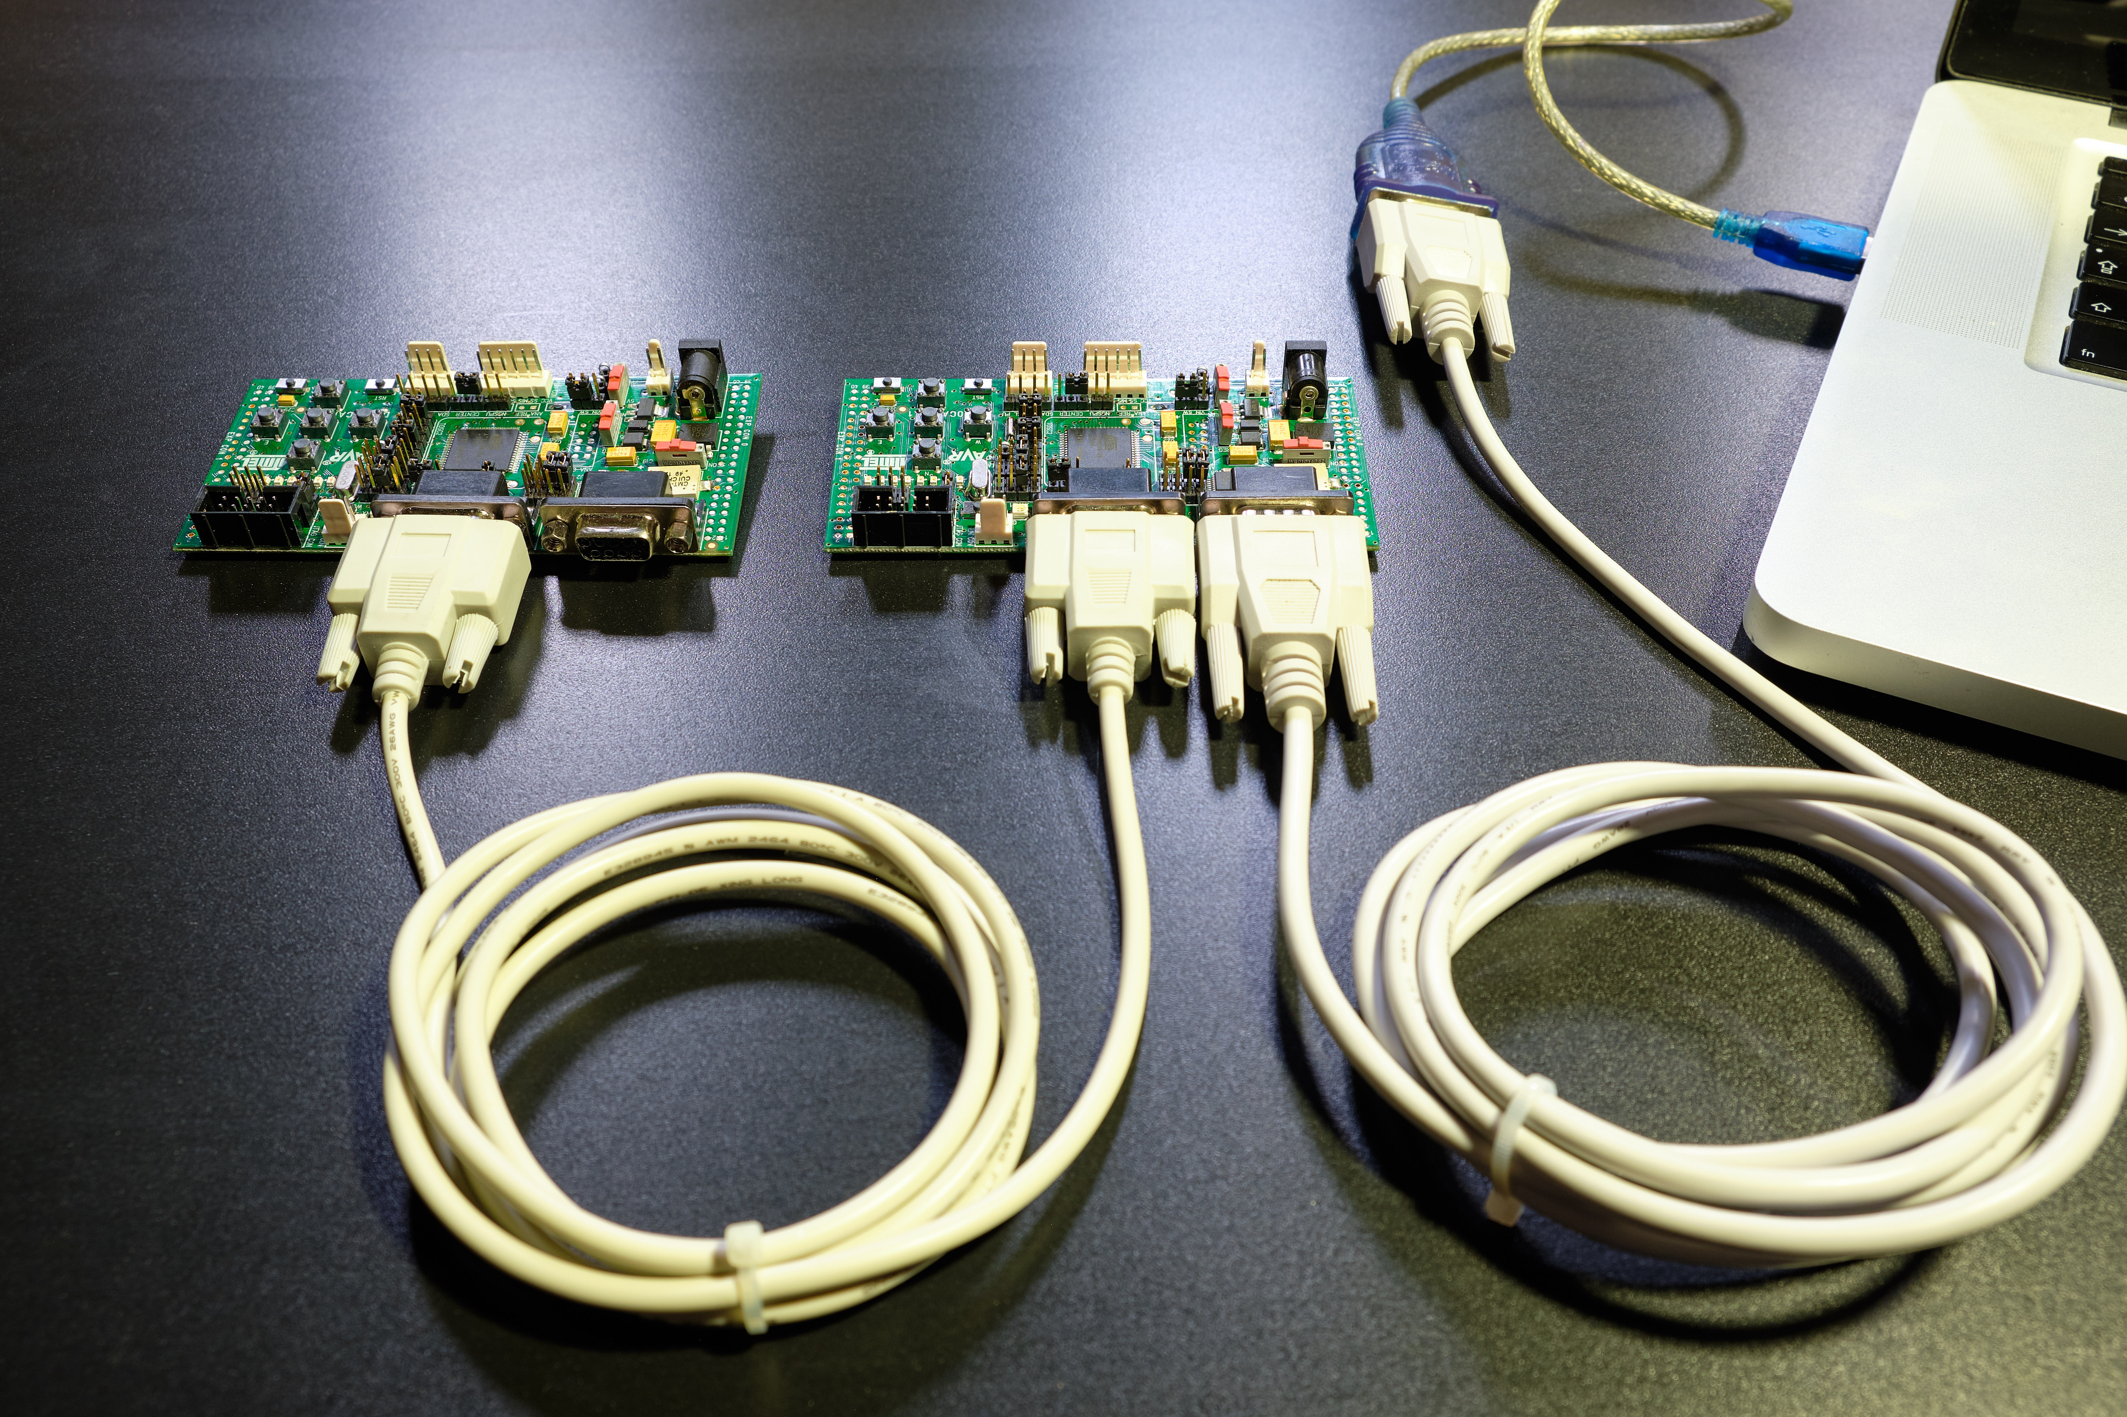
Implementation
Set-Up:
C Libraries:
Micro-ECC for ECC, ECDSA and ECDH
AVR-Crypto-Lib for SHA256, SHA512 and HMAC-SHA256
ISOTP-C for ISO-TP
https://github.com/kmackay/micro-ecc
https://github.com/cantora/avr-crypto-lib
https://github.com/lishen2/isotp-c
Notes:
OBD-II Server: Implemented on the tester (key API).
Intra vehicle network: RS232 connection with PC.
ECC because of it’s speed (make comparison like 26 minutes (RSA DS) versus 6 seconds (ECDSA). Atmega328 microcontroller 16Mhz
SHA-2 because they are more efficient than SHA-3 + more software libraries available

Slide 24
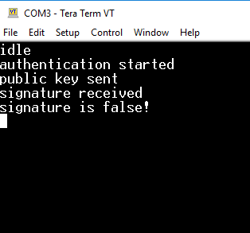
Implementation
Scenario 1
Role: Owner

Slide 25
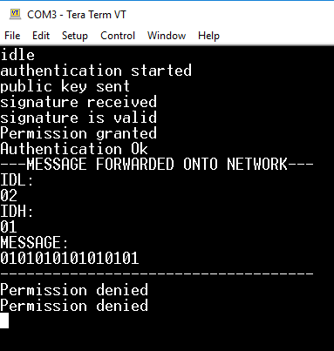
Implementation
Scenario 2
Role: Owner

Slide 26
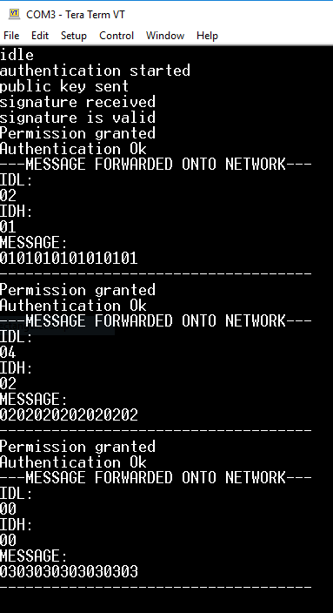
Implementation
Scenario 3
Role: Admin

Slide 27
Evaluation

Slide 28
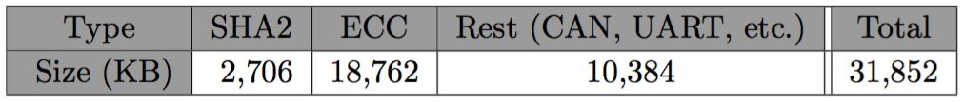
Evaluation
Compatibility:
Program Memory:
Flash Memory utilization: 22%
RAM: 3 KB (ECC)
Notes:
32 KB is pessimistic estimate (ISO-TP, CAN, etc already implemented on gateway), CAN is about 4,5 KB.
Typical Program memory also within acceptable bounds.
Typical RAM up to several megabytes (so 3KB is ok) (Atmel, Infineon, ST).
Typical ECUs, has built-in hardware modules for ECC and SHA2, this means that the utilisation in real scenarios more or less will not exceed 1%.

Slide 29
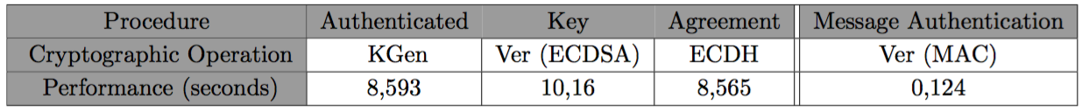
Evaluation
Performance:
ECC operations take significant time
Decoupling necessary
Notes:
Most important procedures are the cryptographic ones, since each message takes only roughly 1.04 ms (online CAN speed calculator).
ECC operations very slow. Although modern gateways would have better performance + these operations can be implemented in hardware.
It is necessary to decouple OBD-II authentication and normal Gateway operation (i.e. signal mapping) to prevent system from shutting down (Dual processing, etc..)

Slide 30
Evaluation
Security:
Authentication
Authorisation
Replay Attack Resistant
Integrity
Confidentiality
Side Channel Attack Resistant
Notes:
Authentication: The user is authenticated in 2 steps: first to the OBD-Server (secure channel) + To the Gateway via the authentication procedure (ECDSA).
Once user disconnects: New authentication required. (Attacker would have to guess ECC private key or ECDSA signature).
Authorisation: OBD-II Server assigns roles to appropriate users + Permissions table enforces security policy.
Replay attacks: MAC prevents replay attacks (Generated public key is random -> secret also random) + Session timeouts.
Integrity: attacker would have to guess MAC/secret (this also holds for an attacker injecting their own messages).
Confidentiality: Private keys safely stored on OBD-II server. Session keys deleted when session ends.
Side channel attack: no secret data stored on gateway + session keys deleted.
Overall security is reduced to security of the cryptographic primitives: ECC and HMAC (guess private key, guess shared secret, guess signature, guess MAC).

Slide 31
Conclusion

Slide 32
Conclusion
Contribution in Review
The proposal of a role-based access control model for OBD-II, based on public-key cryptography.
Provide open source ‘proof-of-concept’ implementation on resource-constrained hardware and evaluate based on proposed challenges.
Future Work
First step taken towards securing OBD-II.
Notes:
Future work OBD-II Roles, Permission Table, Central Server, Tester and OBD-II Applications

Slide 33
Thank you!
Notes:
Thanks to: My assistants, Bruno Crispo,

Slide 34
Questions?

Slide 35
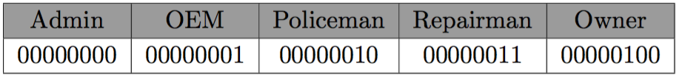
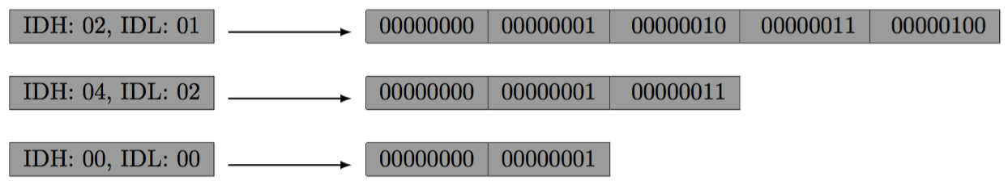
XImplementation
Permission Table Implementation

Slide 36
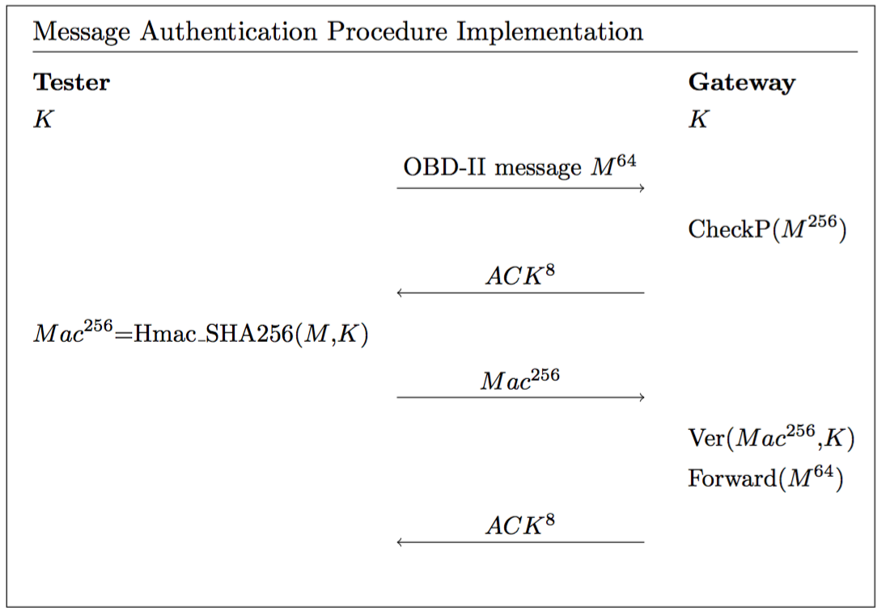
XImplementation
Notes:
Discuss implementation(ISO-TP!!!)
Again MAC size to guarantee security level.

Slide 37
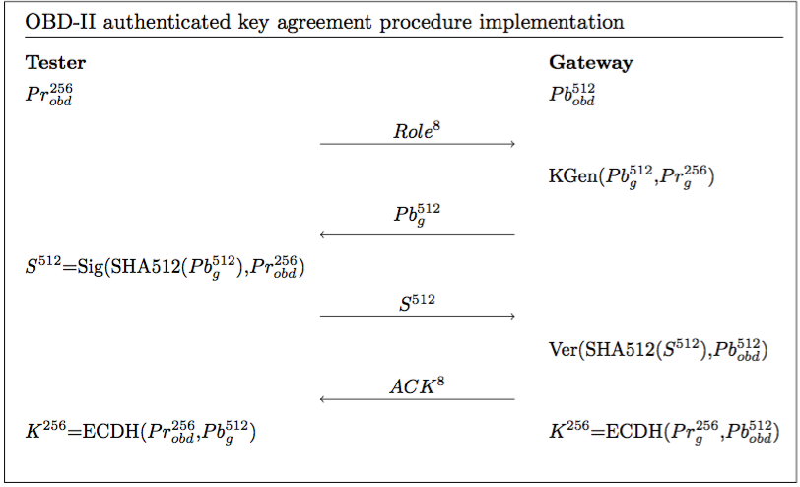
XImplementation
Notes:
Discuss implementation (everything is transmitted using ISO-TP!!!)
Security level of 128 bits.
Private/public key size to guarantee security level.
Signature size to guarantee security level.
Shared secret size to guarantee security level.

Slide 38
XBackground – Software Security Preliminaries
Asymmetric key cryptography: ECC, ECDSA and ECDH.
Symmetric key cryptography: HMAC-SHA256.
Cryptographic Hash functions: SHA256 and SHA512.

Slide 39
Background – CAN
Security Issues:
Eavesdropping
No authentication
No encryption
Denial of service (DoS)
Robert Buttigieg, Mario Farrugia, and Clyde Meli. Security issues in controller area networks in automobiles. Technical report, University of Malta, 2017.
Stephen Checkoway, Damon McCoy, Brian Kantor, Danny Anderson, Hovav Shacham, Stefan Savage, Karl Koscher, Alexei Czeskis, Franziska Roesner, and Tadayoshi Kohno.
Comprehensive experimental analyses of automotive attack surfaces. Technical report, University of California, San Diego and University of Washington.

Slide 40
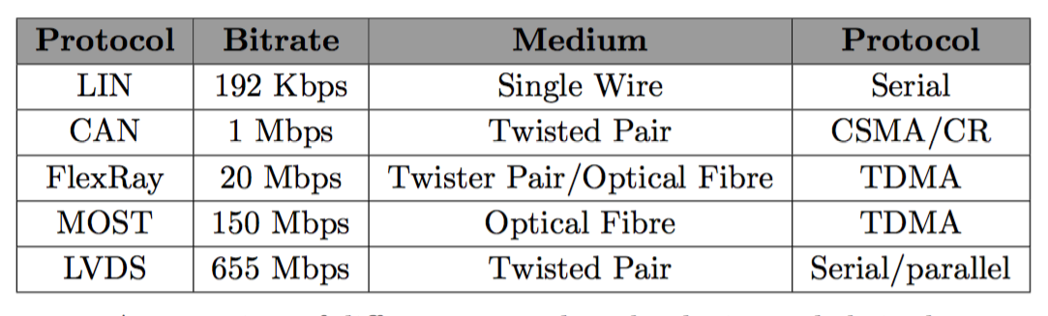
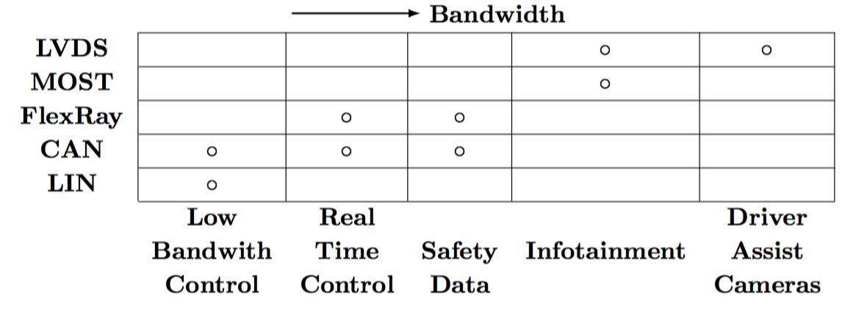
XBackground – Intra vehicle networks
Shane Tuhoy, Martin Glavin, Ciar ́an Hughes, Edward Jones, Mohan Trivedi, and Liam Kilmartin. Intra-vehicle networks: A review. IEEE Transactions on Intelligent Transportation Systems, January 2014.

Slide 41
Evaluation
Security:
Physical access attacks: ECDSA + Permission table + OBD-II Server
Remote session hijacking: HMAC-SHA256.
OBD-Server:
Private key storage.
Private key API.
User Authentication.
Cryptographic primitives.
Notes:
Physical attacks: users are prevented from gaining unauthorised access via the OBD-II port because authentication is required first (AUTHENTICATION).
If access is granted, the permission table enforces a policy that is designed to limit access according to the user’s role (AUTHORISATION).
The OBD-II Server ensures that only authorised users are granted the ability to authenticate with the appropriate role.
Remote Session Hijacking: Tampering, replaying, etc is prevented by the use of the session key that changes frequently (HMAC_SAH256) (REPLAY ATTCK + INTEGRITY).
OBD-Server is in charge of safely storing the private keys (CONFIDENTIALITY) + Providing a safe private key api (signature generation + Shared secret establishment) + Secure user authentication (login + password).
Overall security is reduced to security of the cryptographic primitives: ECC and HMAC (guess private key, guess shared secret, guess signature, guess MAC).

Slide 42
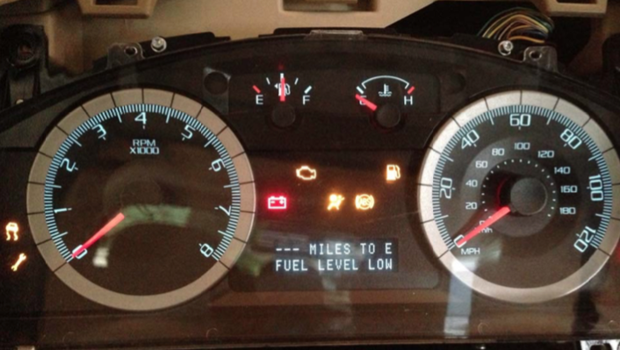
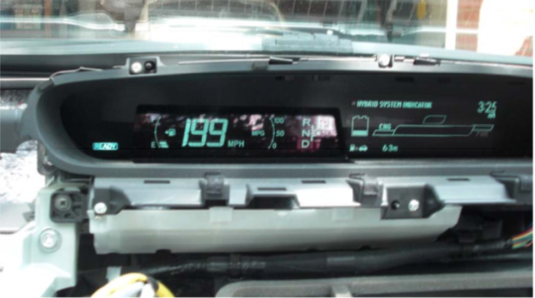
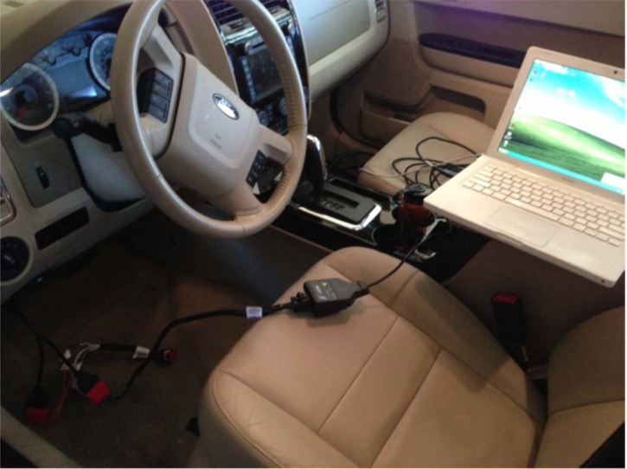
Attacker Model
Example Attacks:
Cyber security and resilience of smart cars. Technical report, Agency for Network and Information Security (ENISA), 2016.
Charlie Miller and Chris Valasek. Adventures in automotive networks and control units. 2014.
Notes:
Attacker types + Example attacks

Slide 43
Securing the OBD-II port
Example Attacks:
Speedometer.
Denial of Service.
Diagnostic Session.
Charlie Miller and Chris Valasek. Adventures in automotive networks and control units. 2014.
Notes:
Clicking shows multiple pictures.
Diagnostics session: explain seed key + weakness.

Slide 44
Attacker Model – Remote Session Hijacking
Central Gateway
Sub-Networks
CAN
User
Attacker
Intra Vehicle Network

Slide 45
Attacker Model – Physical Access
Central Gateway
Sub-Networks
CAN
Attacker
Intra Vehicle Network

Slide 46
Background – OBD-II
OBD-II security issues:
Provides direct access to intra vehicle network.
Inherits security issues of underlying signalling protocol (i.e. CAN):
Eavesdropping
Denial of Service
etc.

Slide 47
Background – OBD-II
Signalling Protocol ISO 15765 CAN (ISO-TP).
Speed: 250 or 500 kbit/sec.
Message length up to 4095 bytes.
Split message up into different CAN frames.
First data byte = Protocol control information (PCI).
4 types: Single (SF), First (FF), Consecutive (CF), Flow Control (FC).
ISO 15765-2:2016 Road vehicles -- Diagnostic communication over Controller Area Network (DoCAN) -- Part 2: Transport protocol and network layer services, Standard, Internation Organisation for standardization, 2016.
Notes:
Mandatory in all vehicles since 2008.
Essentially every CAN message 7 bytes of data + 1 byte of PCI.

Slide 48
Background – OBD-II
ISO-TP frame types:
Single Frame (SF) = 0.
First Frame (FF) = 1.
Consecutive Frame (CF) = 2.
Flow control Frame (FC) = 3.
ISO 15765-2:2016 Road vehicles -- Diagnostic communication over Controller Area Network (DoCAN) -- Part 2: Transport protocol and network layer services, Standard, Internation Organisation for standardization, 2016.

Slide 49
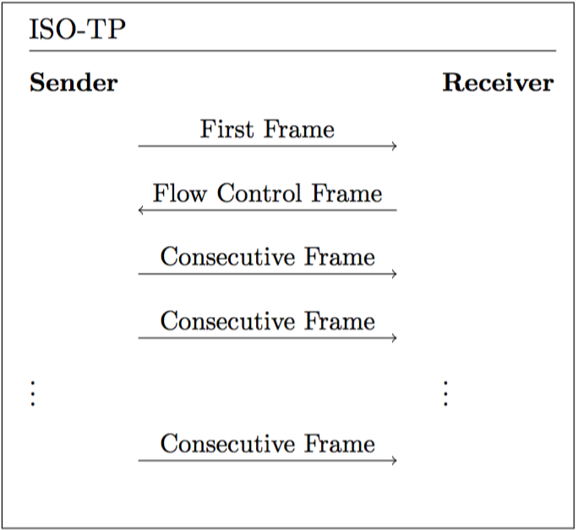
Background – OBD-II
ISO-TP:
ISO 15765-2:2016 Road vehicles -- Diagnostic communication over Controller Area Network (DoCAN) -- Part 2: Transport protocol and network layer services, Standard, Internation Organisation for standardization, 2016.
Notes:
Message longer than 7 bytes.
Consecutive frames until entire payload was delivered.

Slide 50
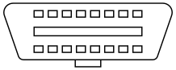
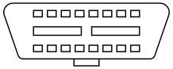
Background – OBD-II
Data Link Connector (DLC)
Type A
Type B
ISO15031-3. Road vehicles – communication between vehicle and external equipment for emissions-related diagnostics – part 3: Diagnostic connector and related electrical circuits: Specification and use. Standard, International Organization for Standardization, 2016.
Wikipedia contributors. On-board diagnostics — Wikipedia, the free encyclopedia, 2018. [Online; accessed 29-November-2018]. URL: https://en.wikipedia. org/w/index.php?title=On-board_diagnostics&oldid=870086948.
Notes:
Both are female connectors (found in vehicles)
law it is required to be installed within 0.61 m of the steering wheel
Type A uses 12V signal levels.
Type B uses 24V signal levels.
Design prevents insertion of type A male plug into a type B female socket

Slide 51
Background – CAN
Message Arbitration:
CAN ID bit either dominant (0) or recessive (1).
Upon multiple concurrent transmission: arbitration.
Lower ID = Higher priority.
ISO11898-1. Road vehicles – controller area network (can) – part 1: Data link layer and physical signalling. Technical report, International Organization for Standardization, 2015.
ISO11898-2: Road vehicles – controller area network (can) – part 2: High-speed medium access unit. Standard, International Organization for Standardization, 2016.
ISO11898-3: Road vehicles – controller area network (can) – part 3: Low- speed, fault-tolerant, medium-dependent interface. Standard, International Organization for Standardization, 2016.
Notes:
Explain how message arbitration works.

Slide 52
Background – CAN
Frames:
Data frame
Error frame
Remote frame
Overload frame
ISO11898-1. Road vehicles – controller area network (can) – part 1: Data link layer and physical signalling. Technical report, International Organization for Standardization, 2015.
ISO11898-2: Road vehicles – controller area network (can) – part 2: High-speed medium access unit. Standard, International Organization for Standardization, 2016.
ISO11898-3: Road vehicles – controller area network (can) – part 3: Low- speed, fault-tolerant, medium-dependent interface. Standard, International Organization for Standardization, 2016.
Notes:
Explain goal of each frame type

Slide 53
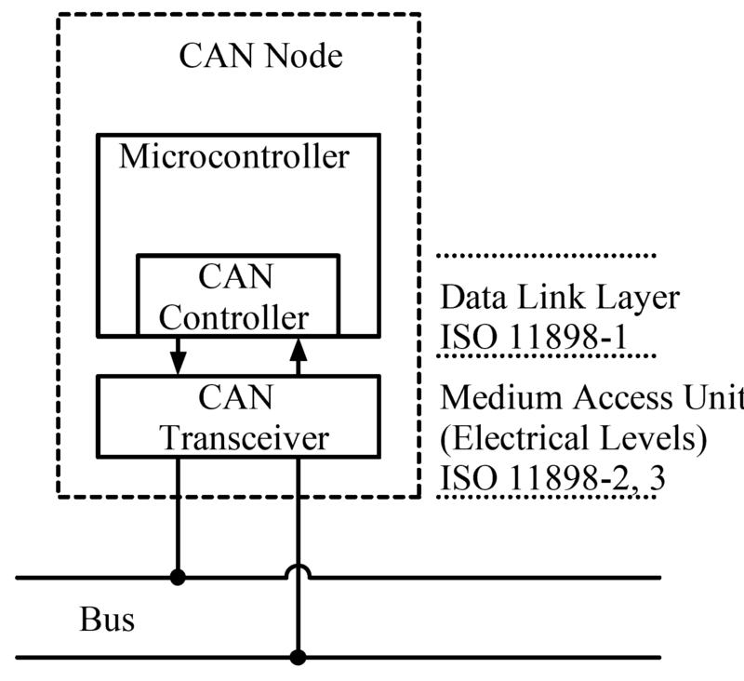
Background – CAN
Architecture:
Wikipedia contributors. Can bus — Wikipedia, the free encyclopedia, 2018. [Online; accessed 29-November-2018]. URL: https://en.wikipedia.org/w/ index.php?title=CAN_bus&oldid=870995924.
Notes:
CAN Transceiver: implements physical layer.
CAN Controller: Transfer layer.
MCU: Object Layer + Application Layer.
CAN node = ECU

Slide 54
Background – CAN
Layers:
Application Layer.
Object Layer.
Transfer Layer.
Physical Layer.
ISO11898-1. Road vehicles – controller area network (can) – part 1: Data link layer and physical signalling. Technical report, International Organization for Standardization, 2015.
ISO11898-2: Road vehicles – controller area network (can) – part 2: High-speed medium access unit. Standard, International Organization for Standardization, 2016.
ISO11898-3: Road vehicles – controller area network (can) – part 3: Low- speed, fault-tolerant, medium-dependent interface. Standard, International Organization for Standardization, 2016.
Notes:
Explain general responsabilities of each layer.

Slide 55
Introduction
Potential hacking results.
Vehicle Theft.
Changing Emission information (“Dieselgate”).
Reduce odometer value.
Change recorded data after crash.
…
EXTREMETECH, „Hack the diagnostics connector, steal yourself a BMW in 3 minutes
Stephanie Bayer, Thomas Enderle, Dennis Kengo Oka , Marko Wolf .
Security Crash Test – Practical Security Evaluations of Automotive Onboard IT Components

Slide 56
Introduction
Automobile hacking has become one of the major concerns for software security today:
Over 100M lines of code deployed over more than 70 ECU’s.
Networking protocols (e.g. CAN).
Increasing connectability (Bluetooth, Wifi, etc).
Lee Pike, Jamey Sharp, Mark Tullsen, Patrick C. Hickey and James Bielman. 2015.
Securing the automobile: A comprehensive approach.
Dan Klinedinst, Christopher King. 2016
On Board Diagnostics: Risks and Vulnerabilities of the Connected Vehicle
Notes:
Increasing connectability = Emergence of new attack surfaces.

Slide 57
Survey vulnerabilities of the OBD-II interface.
The proposal of a role-based access control model for OBD-II, based on public-key cryptography.
Provide open source ‘proof-of-concept’ implementation on resource-constrained hardware and evaluate based on proposed challenges.

Slide 58
Introduction
Automobile hacking has become one of the major concerns for software security today:
Over 100M lines of code deployed over more than 70 ECU’s.
Networking protocols (e.g. CAN).
Increasing connectability (Bluetooth, Wifi, etc).
Lee Pike, Jamey Sharp, Mark Tullsen, Patrick C. Hickey and James Bielman. 2015.
Securing the automobile: A comprehensive approach.
Dan Klinedinst, Christopher King. 2016
On Board Diagnostics: Risks and Vulnerabilities of the Connected Vehicle

Slide 59

OBD-II

Slide 60
Security Issues
No source address => No certainty about origin.
Broadcast nature => Information Disclosure.
Prioritized ID’s => Denial of Service.
No support for encryption or authentication.
’CAN, by design, offers no protection from manipulation’
(Miller, 2013), (Koscher, 2010)

Slide 61


Threat Model
Physical Access to OBD-II DLC.
Ability to inject arbitrary packets.
Able to exploit vulnerabilities in ECU software.
Vehicle Network

Slide 62
OBD-II Access Control

Slide 63
Introduction
Thesis Subject: Role Based Access Control.
Every role determines what kind of access is permitted.
For example:
Repair shop => Read diagnostics information only.
Official dealership => Diagnostics + ability to fix/test faulty ECU’s.
Police => Check integrity of vehicle network.

Slide 64
Introduction
Central Gateway
Private Key
Public Key
Vehicle Network

Slide 65
Introduction
Challenges:
PKI infrastructure.
Authentication protocol (challenge response).
Permissions table.
Secure private key API.

Slide 66
Security, Vulnerability and Protection of Vehicular On-board Diagnostics
Aastha Yadav, Gaurav Bose, Radhika Bhange, Karan Kapoor, N.Ch.S.N Iyengar, Ronnie D. Caytiles
VIT University.Vellore-632014, Tamilnadu, India, Hannam University, Korea

Slide 67
Paper - Introduction
Outline:
Introduction
Motivation
Background Research
Points Entry
On-Board Diagnostic (OBD)-II Port
OBD-II Port Security Threats
Security Solution
Conclusion

Slide 68
Paper - Introduction
Outline:
Introduction
Motivation
Background Research
Points Entry
On-Board Diagnostic (OBD)-II Port
OBD-II Port Security Threats
Security Solution
Conclusion

Slide 69
Security, Vulnerability and Protection of Vehicular On-board Diagnostics
Aastha Yadav, Gaurav Bose, Radhika Bhange, Karan Kapoor, N.Ch.S.N Iyengar, Ronnie D. Caytiles
VIT University.Vellore-632014, Tamilnadu, India, Hannam University, Korea
Proposed Security Solutions

Slide 70
Security Solutions – Seed Key Algorithm
Implement security at ECU level.
Every ECU holds a secret key.
Algorithm:
Tester sends a PID to the ECU.
ECU sends a seed value to the Tester.
Both ECU and Tester calculate response from seed and secret key.
Tester sends response to ECU where it is verified.

Slide 71
Security Solutions – Seed Key Algorithm
Security Issues:
Same secret key shared.
Secret key stored in unprotected memory.
Algorithms are proprietary and Confidential (Security through Obscurity).
Seed values often too short ( 10 min to crack 16 bit seed ).
K. Koscher, A. Czeskis, F. Roesner, S. Patel, T. Kohno, S. Checkoway, D. McCoy, B. Kantor, D.Anderson and H.a.o. Shacham,
"Experimental security analysis of a modern automobile", Security and Privacy (SP), 2010 IEEE Symposium on, (2010).

Slide 72
Security Solutions – Two Way Authentication
Extends Seed-Key Algorithm.
Introduce device that allows client (owner of car) to control access to the OBD-II port.
Device can be a pager, cell phone, smartphone app, bluetooth, etc.
Device allows client to receive and send acknowledgments.

Slide 73
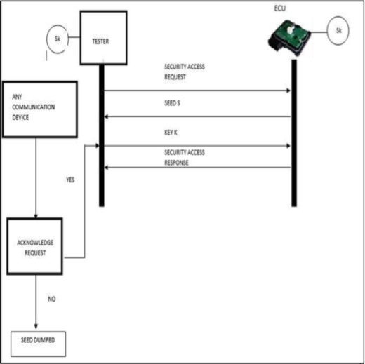
Security Solutions – Two Way Authentication

Slide 74
Security Solutions – Timer Method
Extends Two-Way authentication method.
Introduces 2 things:
Timer started once seed is received, if it runs out the client is notified.
Client needs to enter code when completing acknowledgement.
Timer should prevent brute force attacks.

Slide 75
Paper – My Issues
Solution assumes official tester device.
Custom tester software could use revealed secret keys.
Custom tester software would bypass two-way authentication.
Implementation uses small key and seed sizes.
Demo uses 5 bit seeds and keys.
ECU is implemented only virtually (no CAN).

Slide 76
Current Thesis Status

Slide 77
Current Thesis Status
2 DVK90CAN1 AVR development boards (AT90CAN128).
Gateway:
Holds public keys & permissions table.
Tester:
Implements private key API.
Authenticate & send OBD-II messages.

Slide 78
Current Thesis Status
Authentication Request.
Remote CAN frame
With Specific ID
Tester
Gateway

Slide 79
Current Thesis Status
Challenge
2 CAN Frames
128 bit Challenge
Tester
Gateway

Slide 80
Current Thesis Status
Key Attestation
8 CAN frames
512 bit Signature of Challenge
Tester
Gateway

Slide 81
Current Thesis Status
Elliptic Curve Digital Signature Algorithm.
Key Size:
Security level is Key Size / 2 (smaller key than normal DSA).
According to NSA 256 bit key sufficient (128-bit security level) .
Signature Size:
Security level is Signature size / 4.
A signature of size 512 bit will be sufficient (128-bit security level).
https://en.wikipedia.org/wiki/Key_size#cite_note-19
https://en.wikipedia.org/wiki/Elliptic_Curve_Digital_Signature_Algorithm

Slide 82
Current Thesis Status
Authentication Request.
Remote CAN frame
Acknowledgment
Tester
Gateway

Slide 83
Current Thesis Status
Send OBD-II message
OBD-II message
Tester
Gateway

Slide 84
Current Thesis Status
Former protocol is for sending 1 OBD-II message.
If multiple messages are to be sent shared secret is established:
Elliptic Curve Diffie-Hellman
Shared secret used as new symmetric key.
Every OBD-II message followed by MAC of message using shared symmetric key.
Periodically new symmetric key established.

Slide 85
Current Thesis Status
Current Implementation:
Relevant Microcontroller functions explored.
2 AVR boards can send and receive CAN messages.
Serial link between board and pc (for demo).
Elliptic Curve Library (micro-ecc) imported and tested (Key Storage).
https://github.com/kmackay/micro-ecc

Slide 86
Planning next 2 months

Slide 87
Planning
Implementation:
Finish Authentication + ECDH protocol.
Build permissions table.
Tester private key API.
represents online API for interacting with private keys.
This API should be secure!
Testing.

Slide 88
Planning
Writing:
Finishing touches: Literary Review, Background (CAN & OBD-II), Contributions, Introduction and Abstract.
OBD-II Access control (explanation of implemented protocol).
Formulation and interpretation of test results.
Conclusion.

Slide 89
Questions?

Slide 90
OBD-II
On Board Diagnostics Protocol.
Help Technicians Diagnose and Repair Complex Problems
Allows access to vehicle subsystems via connector.
Introduces parameter ID’s (PID) to request data from ECU’s.
PID manufacturer and model specific.
Works with multiple signalling protocols, but CAN mostly used.
https://en.wikipedia.org/wiki/On-board_diagnostics

Slide 91
OBD-II
Vehicle Network

Slide 92
OBD-II
OBD-II
Data Link Connector
Vehicle Network

Slide 93
OBD-II
Diagnostic
Scan Tool
Vehicle Network

Slide 94
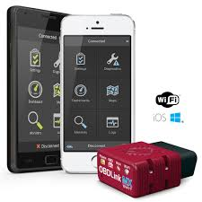
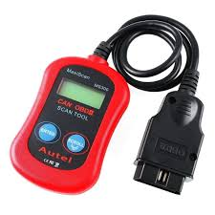
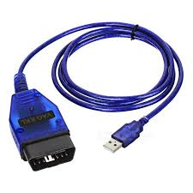
OBD-II
Scan Tools.

Slide 95
OBD-II
CAN Bus
Vehicle Network

Slide 96
CAN
Controller Area Network.
Bus allowing communications between ECU’s inside the vehicle.
Message Based Protocol (Frame).
Carrier Sense Multiple Access with Collision Avoidance (CSMA/CA).
Not only communications protocol implemented in vehicles (cf LIN, MOST) but most common.
https://en.wikipedia.org/wiki/CAN_bus

Slide 97
OBD-II
Vehicle Network

Slide 98
Security Issues

Slide 99
Security Issues
No source address => No certainty about origin.
Broadcast nature => Information Disclosure.
Prioritized ID’s => Denial of Service.
No support for encryption or authentication.
’CAN, by design, offers no protection from manipulation’
(Miller, 2013), (Koscher, 2010)

Slide 100
Threat Model
Physical Access to OBD-II DLC.
Ability to inject arbitrary packets.
Able to exploit vulnerabilities in ECU software.
Enable wireless connectivity.
Vehicle Network

Slide 101
Proposed Solution: OBD-II Role Based Access Control

Slide 102
Solution
Proposed solution: Role Based Access Control.
Every role determines what kind of access is permitted.
For example:
Repair shop => Read diagnostics information only.
Official dealership => Diagnostics + ability to fix/test faulty ECU’s.
Police => Check integrity of vehicle network.

Slide 103
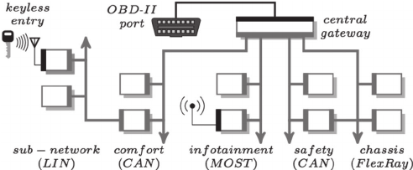
Solution
Central gateway (CGW).
Acts as router for all subnetworks + gate for all incoming data.
Perfect place to implement access control solution.

Slide 104
Private keys
Central Server
Internet
Connection
Central Gateway
Sub-Networks
CAN
User
Public Key
Intra Vehicle Network

Slide 105
Solution
Central Gateway
Sub-Networks
CAN
User
Attacker
Intra Vehicle Network

Slide 106
Solution
Central Gateway
Sub-Networks
CAN
Attacker
Intra Vehicle Network

Slide 107
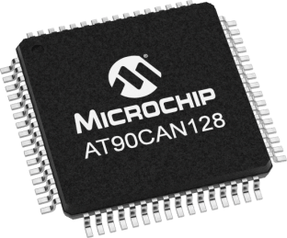
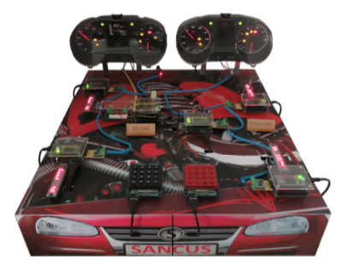
Solution
Implementation:
Microcontroller with CAN controller (AT90CAN128).
CAN Transceiver.
OBD-II connector.
Demo:
CAN testbench designed at KuLeuven for testing VulCAN.
Jo Van Bulck, Jan Tobias Mühlberg, and Frank Piessens
December 2017

Slide 108
Planning Next Three Months

Slide 109
Planning
December:
Get Familiar with Microcontroller software development.
Write December paper/poster.
January & February:
Implement a simple CAN compliant device.
Start Implementing rudimentary access control.

Slide 110
Questions? Notes: - Timing.

Slide 111
Timing difficulties.
Major Challenges!: Key infrastructure, Key size, …
No Slowing Down!!!

Slide 112
CAN Protocol

Slide 113
CAN
Controller Area Network.
Bus allowing communications between ECU’s inside the vehicle.
Message Based Protocol.
Carrier Sense Multiple Access with Collision Avoidance (CSMA/CA).
Not only communications protocol implemented in vehicles (cf LIN, MOST) but most common.

Slide 114
CAN Frame
Name | SOF | ID | RTR | IDE | r0 | DLC | Data | CRC | CRCd | ACK | EOF
No. Bits | 1 | 11 | 1 | 1 | 1 | 4 | 64 | 15 | 1 | 2 | 7
Identity Field
Used to identify each ECU in the vehicle.
Also specifies a priority (Lowest ID = highest priority).
Bitwise contention resolution (1 = Recessive & 0 = Dominant).

Slide 115
CAN Bitwise Contention Resolution
1 | 1 | 0 | 1 | 0 | 0 | 1 | 1 | 0 | 1 | 0
0 | 0 | 1 | 0 | 1 | 0 | 1 | 1 | 0 | 1 | 0
Node 1
Node 3
0 | 1 | 0 | 1 | 1 | 1 | 1 | 1 | 0 | 0 | 1
0 | 0 | 0 | 1 | 0 | 0 | 0 | 0 | 1 | 1 | 0
Node 2
Node 4
Value Transmitted: 0

Slide 116
CAN Bitwise Contention Resolution
1 | 1 | 0 | 1 | 0 | 0 | 1 | 1 | 0 | 1 | 0
0 | 0 | 1 | 0 | 1 | 0 | 1 | 1 | 0 | 1 | 0
Node 1
Node 3
0 | 1 | 0 | 1 | 1 | 1 | 1 | 1 | 0 | 0 | 1
0 | 0 | 0 | 1 | 0 | 0 | 0 | 0 | 1 | 1 | 0
Node 2
Node 4
Value Transmitted: 0

Slide 117
CAN Bitwise Contention Resolution
1 | 1 | 0 | 1 | 0 | 0 | 1 | 1 | 0 | 1 | 0
0 | 0 | 1 | 0 | 1 | 0 | 1 | 1 | 0 | 1 | 0
Node 1
Node 3
0 | 1 | 0 | 1 | 1 | 1 | 1 | 1 | 0 | 0 | 1
0 | 0 | 0 | 1 | 0 | 0 | 0 | 0 | 1 | 1 | 0
Node 2
Node 4
Value Transmitted: 0

Slide 118
CAN Bitwise Contention Resolution
1 | 1 | 0 | 1 | 0 | 0 | 1 | 1 | 0 | 1 | 0
0 | 0 | 1 | 0 | 1 | 0 | 1 | 1 | 0 | 1 | 0
Node 1
Node 3
0 | 1 | 0 | 1 | 1 | 1 | 1 | 1 | 0 | 0 | 1
0 | 0 | 0 | 1 | 0 | 0 | 0 | 0 | 1 | 1 | 0
Node 2
Node 4
Value Transmitted: 1

Slide 119
CAN Frame
Name | SOF | ID | RTR | IDE | r0 | DLC | Data | CRC | CRCd | ACK | EOF
No. Bits | 1 | 11 | 1 | 1 | 1 | 4 | 64 | 15 | 1 | 2 | 7
Data Field
Carries the payload.
Length is 64 so only 8 bytes of data in each message.

Slide 120
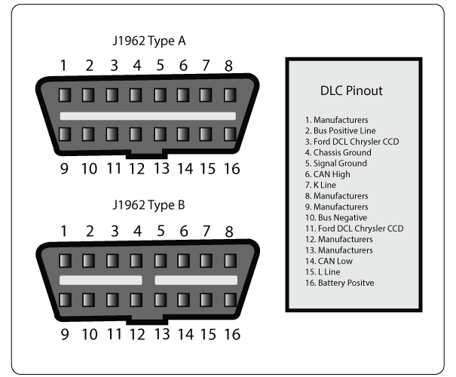
OBD-II

Slide 121
OBD-II
Parameter ID’s (PID)
Codes to request data from a vehicle.
Typical Use (with scan tool connected to DLC):
Technician enters PID on the scan tool.
PID is sent to the CAN bus (accessed via the DLC).
Some ECU recognises the PID and reports the corresponding value on the bus.
Scan tool reads response and displays it to the technician.

Slide 122
OBD-II
Parameter ID’s (PID)
Codes to request data from a vehicle.
Typical Use (with scan tool connected to DLC):
Technician enters PID on the scan tool.
PID is sent to the CAN bus (accessed via the DLC).
Some ECU recognises the PID and reports the corresponding value on the bus.
Scan tool reads response and displays it to the technician.

Slide 123
Security Issues
Potential hacking results (safety critical).
Driver Distractions (wipers etc.).
Engine shutoff.
Steering changes.
…

Slide 124
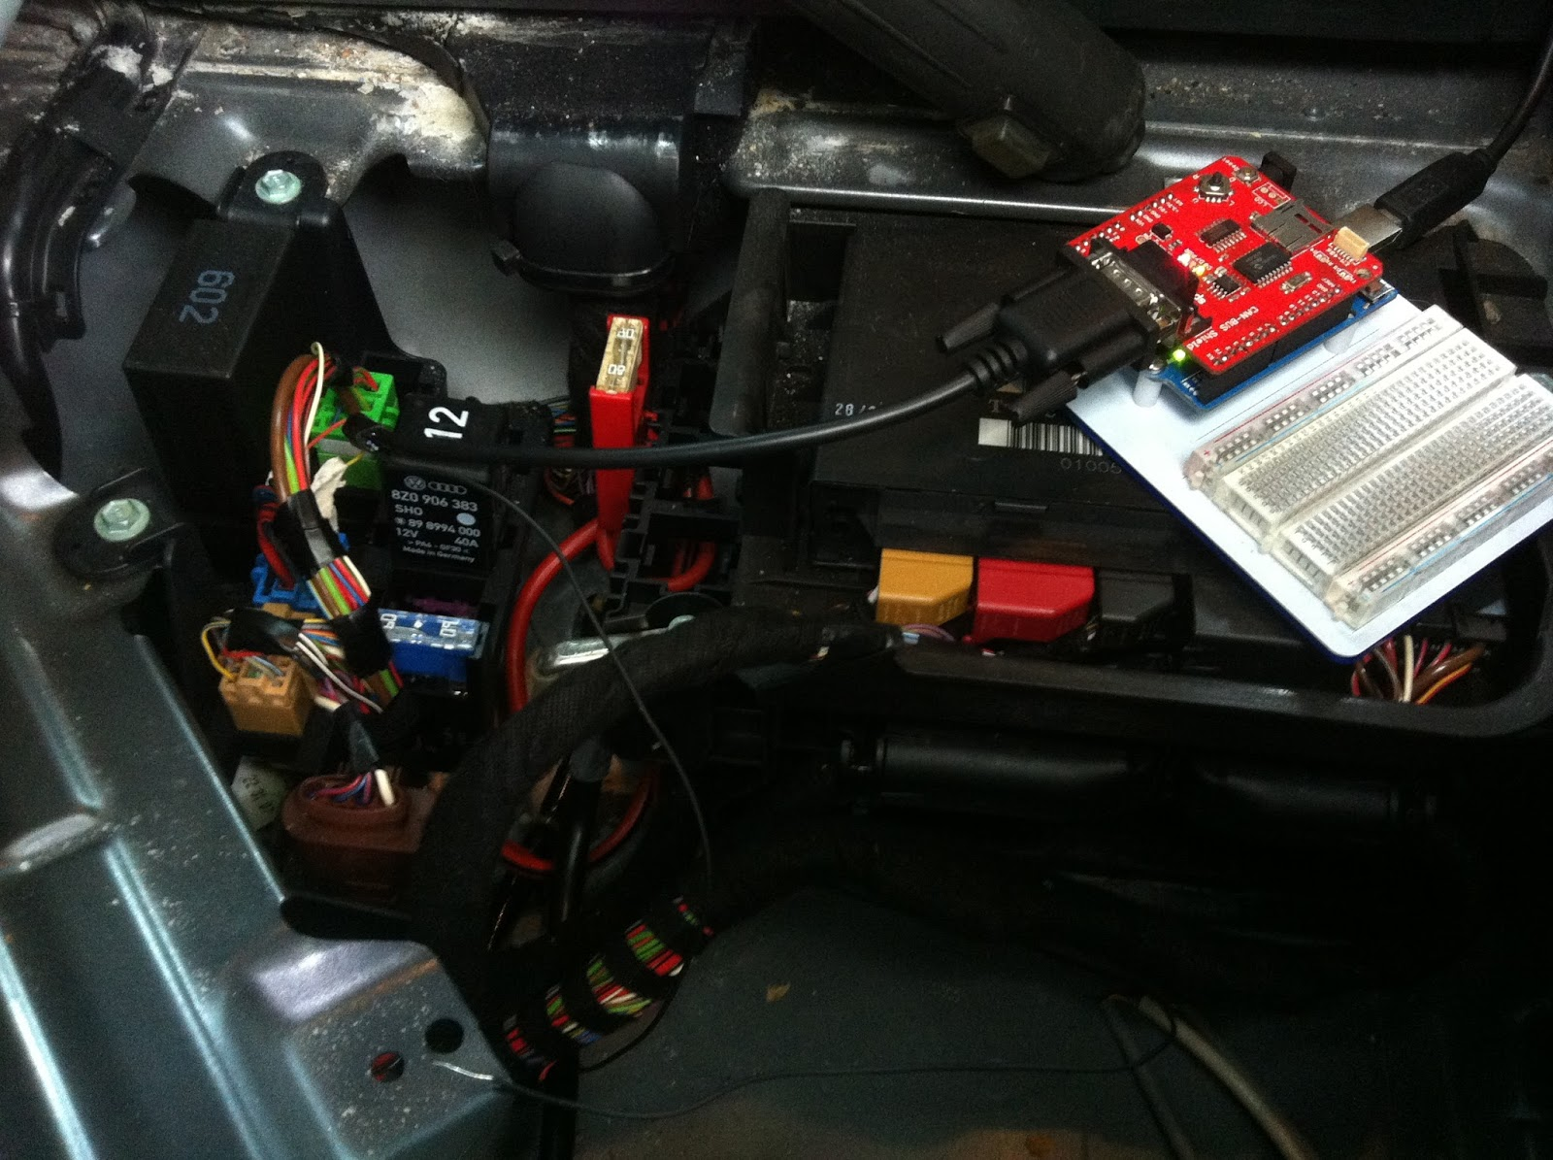
Physical Access
Impossible to completely deny physical access.
Solutions rely on reducing potential harm of unauthorized access:
Seed-key mechanism
Two-way authentication between ECU’s.
Timer method.
Intrusion detection system.
Honeypot.
VulCAN.

Slide 125

Bluetooth
Standard Bluetooth security not sufficient.
Large protocol stack, so susceptible to multiple attacks:
Cipher attacks, Bluejacking, Backdoor attack, etc.
Solutions should apply to the Bluetooth implementation used inside the vehicle.

Slide 126
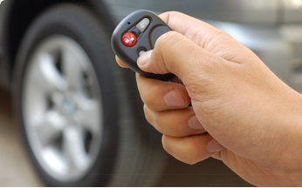
Remote Keyless Entry
Most cars today use RF-based remote keyless entry (RKE)
radio transmitter sends encrypted data containing identifying information.
The ECU can determine if the key is valid and lock, unlock, and start the vehicle

Slide 127
Tire Pressure Monitoring System
Each tire has pressure sensor.
Transmits real time data to an ECU.
Radio signal can be blocked/mimicked.
Solution: ?

Slide 128
Distributed Software

Slide 129
Secure Software & Systems

